Slide 1
Business Creativity
PROJECT: PUBLIC INCLUSIVE TRANSPORTATION
EWC
EveryWay Connect
PRESENTATION

Slide 2
-Type of company: S.A. de C.V.
-Capital Required: 10,000,000 MXN
-Headquarters: Mexico City
EWC
Meet the team:
Paulina Alarcon
Juan Pablo Liceaga
Jaime Novales
Paulo Díaz
Fernanda Baza
Human Resources
CEO/SALES
Marketing
Accounting
Finance

Slide 3
EWC
Table of Contents
About Us
Partners
Capital
Key positions
Location
Administrative structure
Corporate identity
Selling pitch
SWOT/PIVOT
Marketing plan/Sales
Business Creativity

Slide 4
EWC
- Company Name: EveryWay Inclusive Solutions S.A. de C.V
EveryWay Connect is an innovative transportation solution designed to improve mobility for individuals with physical and neurological disabilities in Mexico City.

Slide 5
EWC
Mission &
Vision
Vision: To transform public transportation into an inclusive system that prioritizes accessibility for all.
Mission: Ensure accessibility and inclusion through tailored public transport services.

Slide 7
EWC
Selling Pitch
EWC is a transportation platform designed with one specific mission: no one should be left behind just because they lack proper transportation.
EWC is not just a service; it’s a movement toward real inclusion. Because mobility is a right, and we are here to ensure that everyone can get where they need to go—without barriers and without excuses.
Join us, and let’s make transportation truly for everyone."

Slide 8
EWC
EWC vs. Competitors

Slide 9
EWC
Competitive
Advantage
Focus on Inclusion:
It’s a movement ensuring accessibility for people with disabilities.
Adapted Vehicles:
Unlike Uber, Didi, or public transportation, every vehicle is designed to meet specific needs.
Trained Drivers:
Ensures dignified and professional service for passengers with disabilities, which neither Uber nor public transportation guarantee.
Social Impact:
Beyond business, it aims to transform Mexico’s transportation system to be more inclusive.
Strategic Partnerships:
Potential for subsidies or government support to lower costs and improve accessibility.

Slide 10
SWOT Analysis

Slide 11
PIVOT:

Slide 12
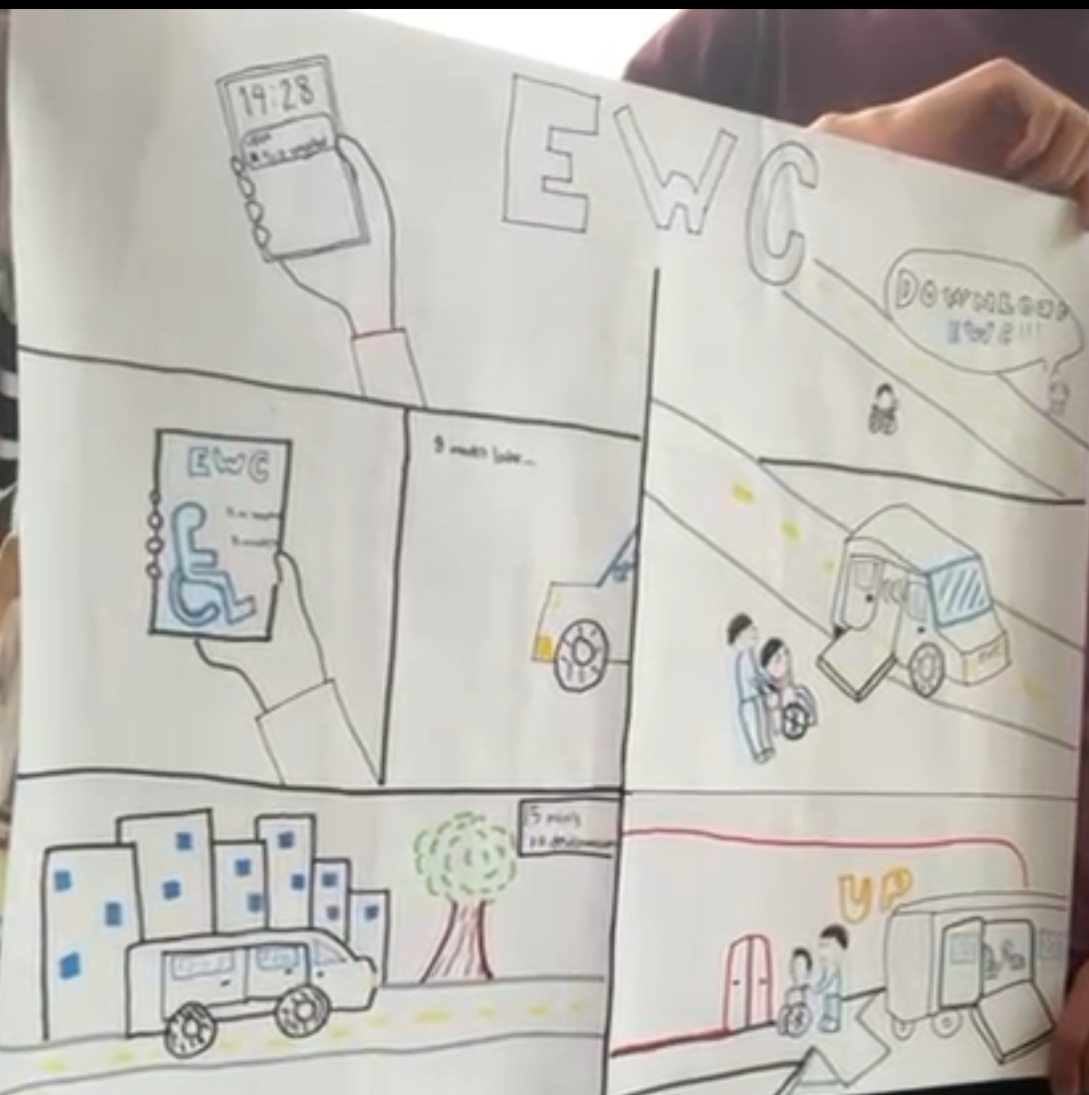

Slide 13
EWC
Marketing plan and sales

Slide 14
Marketing plan and sales
EWC
5 min aprox

Slide 15
Our Challenge
Brand positioning and diferentiation
User Aquisition
User Retention
Pricing Strategy
Trust and safety
Community building
Marketing costs

Slide 16
Bibliography
1. Instituto Nacional de Estadística y Geografía. (s.f.). *Censo de Población y Vivienda 2020: Resultados*. Recuperado de https://inegi.org.mx/app/salaDeprensa/noticia.html?id=6991
2. Metrobús Ciudad de México. (s.f.). *Movilidad inclusiva en Metrobús*. Recuperado de https://www.metrobus.cdmx.gob.mx/dependencia/acerca-de/accesibilidad
3. Gobierno de la Ciudad de México. (s.f.). *Taxis y aplicaciones de transporte en la Ciudad de México*. Recuperado de https://mexicocity.cdmx.gob.mx/e/getting-around/taxis-taxi-apps/?lang=es

